Slide 1
Web Sites Accessibility Evaluation Methodologies Using Guidelines for Indian Government Websites (GIGW), Web Content Accessibility Guidelines (WCAG 2.0) and W3C Mobile Ok Checker

Slide 2
Indian Government web space representing all tiers of governance

Slide 4
Some other countries who are having their own sets of Guidelines
United States
United Kingdom
Germany
France
New Zealand
Italy
Canada
Switzerland
Netherlands
Sweden

Slide 5
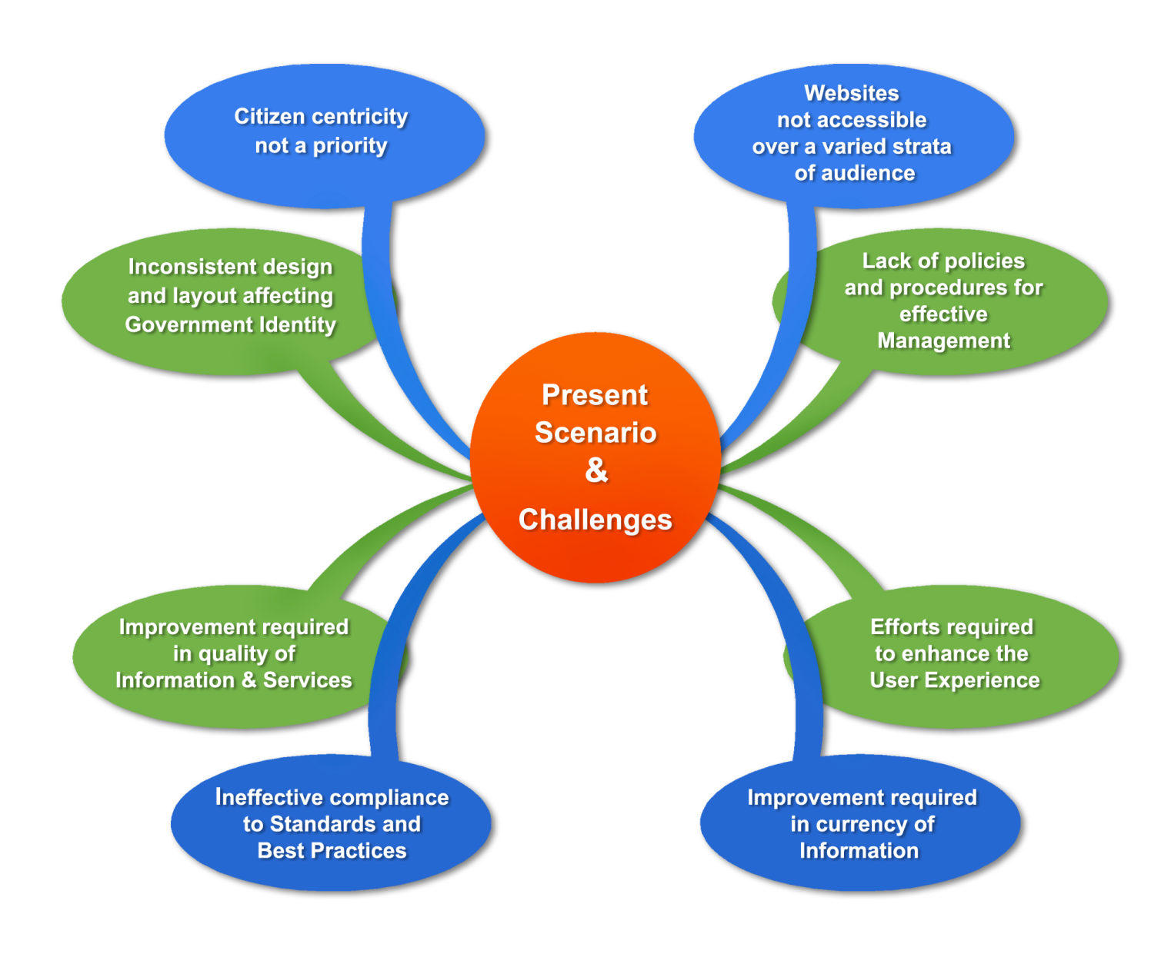
Government Webspace: Challenges

Slide 6
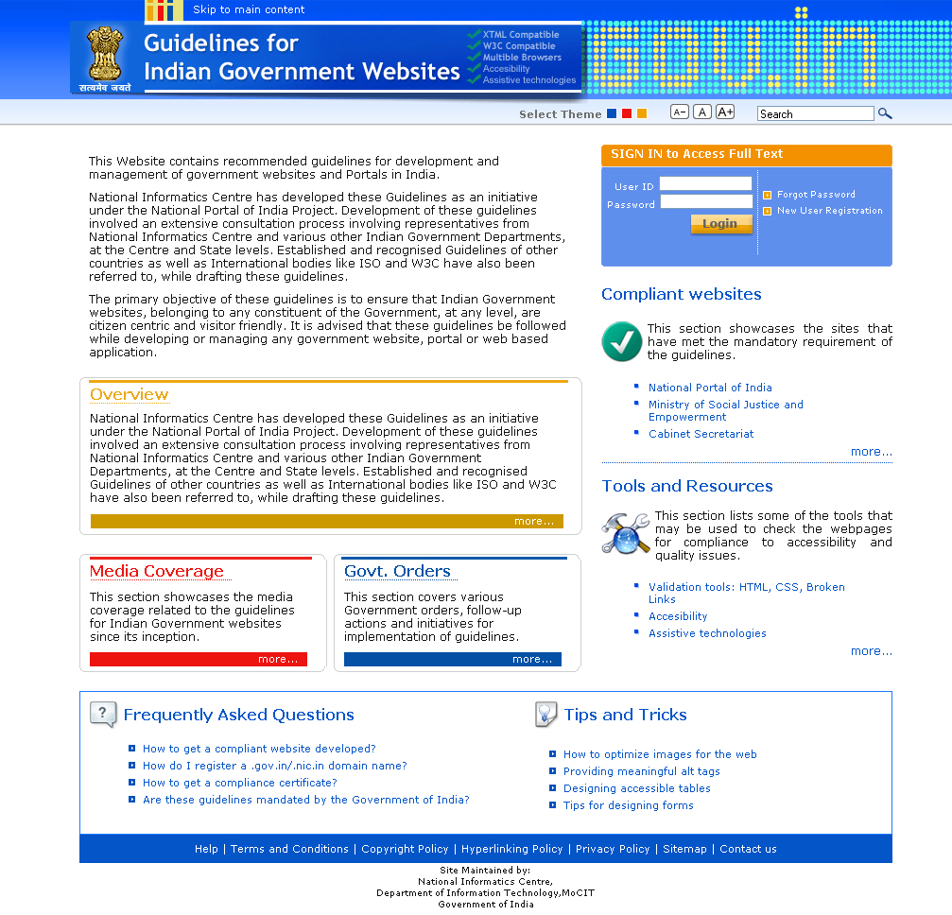
Need was felt to set up a mechanism to ensure certain minimum standard for all government websites. Consequently
‘Guidelines for Indian Government websites’ ( GIGW)
were developed
http://web.guidelines.gov.in/

Slide 7
Guidelines for Indian Government Websites (GIGW)
An Integral Part of Central Secretariat Manual of Office Procedure
Prepared by National Informatics Center
Adopted by Department of Administrative Reforms and Public Grievances and Pension
Published in January 2009
Online: http://web.guidelines.gov.in/

Slide 8
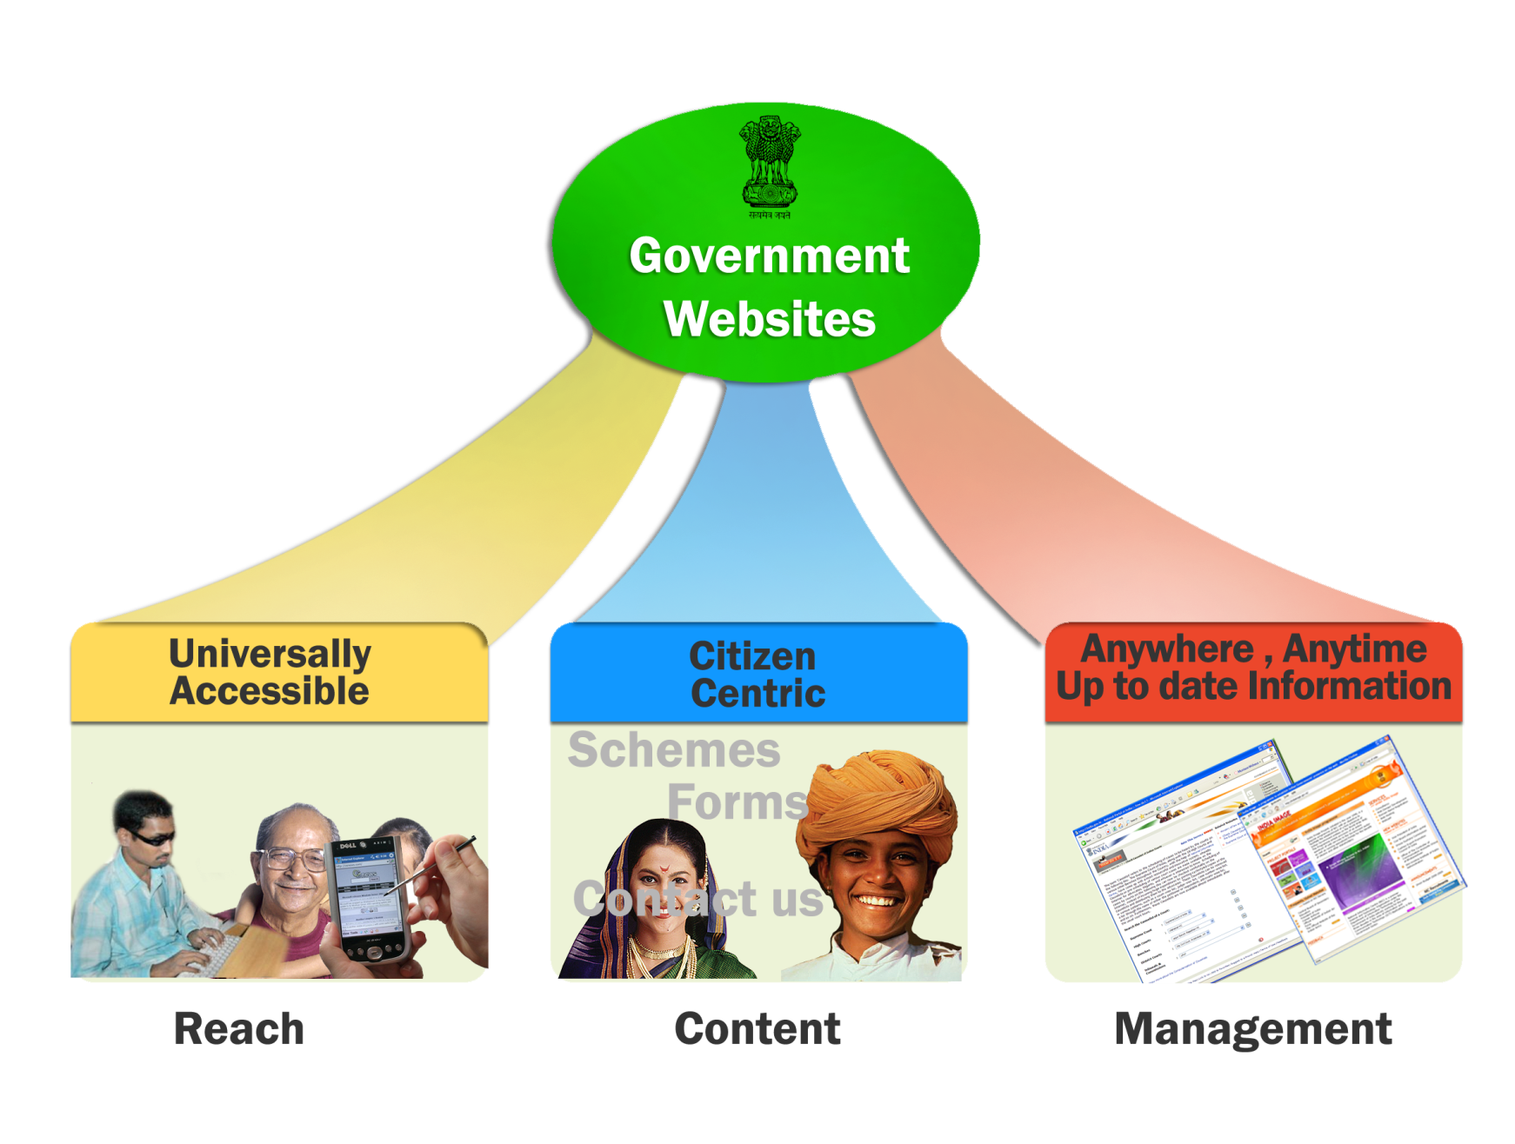
Three Focus Domains of GIGW
Notes:
Universal Accessibility: (Pg 4 GIGW)
The term ‘Universal Accessibility’ refers to making a website accessible to ALL irrespective of technology, platforms, devices or disabilities of any kind. In other words, Departments should consider the needs of a broad spectrum of visitors, including general public, specialised audiences, people with disabilities, those without access to advanced technologies, and those with limited English proficiency. Guidelines to address the above
needs have been given in various sections of this document.
Most pertinent guidelines have been placed in the mandatory category while others have been made advisory or voluntary. Following the mandatory guidelines shall insure compliance to W3C Web Content Accessibility Guidelines (Level A)
Citizen Centric: (Pg 33 GIGW)
Examples of Citizen Centric Services are About us, Schemes, Services, Forms, Acts, Documents, Circulars and Notifications, News and Press Releases, Contact Us, Presence on the National Portal
Website Management Team: (10.1.1 Pg 97 GIGW)
Departments MUST appoint a Web Information Manager whose role shall be to ensure that there is a proper flow of content to the site and that content quality and user satisfaction issues are taken care of. To achieve this she/he has to coordinate with the various groups within the Department. The Web Information Manager should undertake the following activities with regard to the Indian Government website being maintained by her/him.
• Formulation of policies concerning management of content on the web through its entire life cycle viz. Creation, Moderation, Approval, Publishing and Archival. Ensuring that all content on the website is always authentic, up-to-date and obsolete information or services are removed.
• Set a mechanism for periodically validating links to related information. An automated report can provide a list of broken links on the site, which can be immediately corrected.
• Ensuring the entry of the website at a prominent rank in all the major search engines so that the site’s visibility is enhanced and users are made aware of its address.
• Web Information Manager is overall responsible for quality and quantity of information and services on the website. The complete contact details of the Web Information Manager must be displayed on the website, so that the visitor could contact him/her in case of some queries or requirements.
• Since the websites receive a lot of feedback/query mails from the visitors, it is the responsibility of the Web Information Manager to either reply to all of them himself/herself or designate someone to regularly check and respond to the feedback/query mails.
Website Monitoring (10.3 Pg 99 GIGW)
Web being a dynamic medium, changes in terms of technologies, access devices and even the requirements and expectation levels of visitors happen fairly frequently. Keeping this in mind, Indian Government websites MUST have a website monitoring policy in place.Websites must be monitored periodically in accordance with the plan to address and fix the quality and compatibility issues around the following parameters:
a. Performance: Site download time should be optimised for a variety of network connections as well as devices. All important pages of the website should be tested for this.
b. Functionality: All modules of the website should be tested for their functionality. Moreover, interactive components of the site such as discussion boards, opinion polls, feedback forms etc. should be working smoothly.
c. Broken Links: The website should be thoroughly reviewed to rule out the presence of any broken links or errors. A number of tools and techniques are
now available to easily detect the broken links in a websited.
d. Traffic Analysis: The site traffic should be regularly monitored to analyse the usage patterns as well as visitors’ profile and preferences. Traffic Analysis tools also give reports on broken links.
e. Feedback: Feedback from the visitors is the best way to judge a website’s performance and make necessary improvements. A proper mechanism for
feedback analysis should be in place to carry out the changes and enhancements as suggested by the visitors.
Website Policies (10,7 Pg 103 GIGW)
Websites represent the face of the department in the cyber world. Like the Department itself, the website also has to continually grow and evolve. As the website grows in size and reach the expectations of the citizen also grow. It is therefore important that we set down rules and regulations to operate and manage the websites effectively. Although different policies and their need and purpose is explained in various sectionsof this document for the sake of convenience, a complete list of policies along with the section are referenced below.
S.No. Policy Ref No.
1. Copyright Policy 3.1
2. Hyper linking Policy 3.2
3. Terms & Conditions 3.3
4. Privacy policy 3.4
5. Content Contribution, Moderation and Approval Policy (CMAP) 5.2.1
6. Web Content Review Policy (CRP) 5.2.3
7. Content Archival Policy (CAP) 5.2.6
8. Website Security Policy 7.7.2
9. Website Monitoring Policy 10.3
10. Contingency Management 8.3
All the above policy MUST be duly approved by the Head of the Department.

Slide 9
GIGW Compliance
The guidelines are divided into three categories
Mandatory directed towards requirements which can be objectively assessed and which the departments must necessarily comply with ( 115 in number)
Advisory refers to recommended practices that are considered highly important and desirable
Voluntary can be adopted by a Department if deemed suitable
115 mandatory guidelines are presented as a checklist for ready reference & evaluation
Notes:
Mandatory: The usage of term ‘MUST’ signifies requirements which can be objectively assessed and which the Departments are
supposed to mandatorily comply with. It is anticipated that there will be no exceptions for a Department not complying with these. In the case of any Department, these guidelines shall apply to all the WebPages/websites under the ownership of that Department. The websites will be checked against these guidelines when audits for compliance are undertaken or for the purpose of quality certification. It is the responsibility of each Department to address and bring into compliance, any non-compliant issues found in any website under their ownership.
Advisory: The usage of term ‘should’ refers to recommended practices or advisories that are considered highly important and desirable but for their wide scope and a degree of subjectivity these guidelines would have otherwise qualified to be mandatory. Departments are, however, expected to comply with these advisories.
The lineage of the Department should also be indicated at the bottom of the Homepage and all important entry pages of the website. For instance, at the bottom of the Homepage, the footer may state the lineage information, in the following manner:
‘This Website belongs to Department of Heavy Industries, Ministry of Heavy Industries and Public Enterprises, Government of India’ (for a Central Government Department). Pg 11 (GIGW)
Voluntary: The usage of the term ‘may’ refers to voluntary practice, which can be adopted by a Department if deemed suitable. These have been drawn from good practices and conventions that have proved successful and can help a Department achieve high quality benchmarks for their web endeavours.
All currently open vacancies may be highlighted on the Homepage of the website. (Pg 41 GIGW)

Slide 10
GIGW Compliance Assessment
Out of these 115 mandatory guidelines
12% can be fully tested with automated tools
28% can be partially tested with tools but require manual verification
40% need Expert Evaluation
20% need Self Certification
Notes:
Accessibility is about persons with disabilities. It is not possible for a tool alone to claim that a web page or a web application is accessible. Often, accessibility testing is being conducted by using an automated testing tool. To ensure compliance of websites or even to maintain websites this is an important strategy, but we must not ignore the fine print of most accessibility testing tools. Most of these tools will mention that human intervention or checks are required. For example, a testing tool can tell you whether an image has been given an alternate text but it cannot tell you whether the alternate text is accurate. This check needs to be conducted manually.
One of the key areas that we need to invest in is Manual testing along with automated testing tools. In addition, the users that we are building inclusion for are people with disabilities and they have very diverse needs. It is also important to conduct User testing with different types of disabilities to ensure that the website or web application is truly accessible by different user groups. Persons with disabilities actually test the website or application using their assistive technology which might be a screen reader, screen magnifier, reading writing tool, on-screen keyboard, etc.
Validation tools: HTML, CSS, Broken Links
Validation tools are used to check the code for standards compliance. HTML validators , CSS validators and broken link (or dead links) checkers are a few such tools. Following URLs point to some validation tools:
http://validator.w3.org (HTML)
http://jigsaw.w3.org/css-validator/ (CSS)
http://www.cssportal.com/css-validator/ (CSS)
http://juicystudio.com/services/csstest.php#csscheck (CSS)
http://validator.w3.org/checklink/ (Broken Links)
http://juicystudio.com/services/linktest.php (Broken Links)
Accessibility
Accessibility is an important idea behind many web standards. Designing accessible websites will help in creating an inclusive digital world. Accessibility compliance of the Website may be checked at:
http://wave.webaim.org/
http://www.stanford.edu/group/accessibility/cgi-bin/accessibilitychecker/checker/index.php
http://www.etre.com/tools/accessibilitycheck/
Mobile friendliness
Browsing the web is not limited to Personal Computer and Laptops any more. Mobile devices are providing alternate and easy connectivity to Internet. Reach of your website will increase with its availability on mobile devices. Mobile-friendliness of your website may be checked at:
http://validator.w3.org/mobile/

Slide 11
GIGW Compliance: Role of User Testing
Tool based evaluation and expert review alone can not fix the many Accessibility issues in true sense
Look forward to availability of tools to assess more & more compliance through automated systems
Users with different abilities must be included in
Development Process
Evaluation / Assessment Process

Slide 12
GIGW Compliance & Certification
Departments are required to self assess their website for compliance against the GIGW compliance matrix
To make sites conform to the pre-requisites of UUU i.e. Usable, User-Centric and Universally Accessible.
‘Website Quality Certification’ scheme has been launched by Standardization, Testing & Quality Certification (STQC) against compliance to the guidelines.
STQC is an attached office of Department of Information Technology, Government of India
Notes:
In fact, there are specific scripting techniques for WCAG 2, including: [items listed on slide] And there will probably be more in the future.
Reference: Client-side Scripting Techniques for WCAG 2 http://www.w3.org/TR/WCAG20-TECHS/client-side-script.html
---
Note to presenters: This is a particular area that you might want to cover in more or less detail depending on your audience. You can get more about scripting techniques from links in the Techniques document contents list: www.w3.org/TR/WCAG20-TECHS/#contents – as well as other (non-W3C WAI) resources on the Web (however, note that some may be out of date or incorrect).

Slide 13
Scope
Guidelines address the entire lifecycle of the site –planning content design development
hosting management
The "Guidelines for Indian Government Websites" complies with World Wide Web Consortium (W3C) Web Content Accessibility Guidelines (WCAG) 2.0 level A.
Enable people with visual impairments access the sites using assistive technologies, such as screen readers.

Slide 14
Objectives/ Benefits of Compliance
Improve the usability quotient and technical competence of sites vis-à-vis International Standards.
Facilitate sites in achieving citizen-centricity while providing anytime anywhere delivery of information and services.
Formulate policies for sustenance and effective maintenance of the sites through their life cycle.
Achieve a certain degree of commonality and standardization across the sites.
Enhance Government-Citizen Relationship

Slide 15
Website Development Approach
Nominate Web Information Manager at a senior level
Set up a team and formulate policies to monitor & manage site
Identify citizen centric information & services
Develop Information Architecture for better Accessibility & Navigation
Redesign/ upgrade the site in compliance to the Guidelines

Slide 16
Compliance Matrix
Compliance Matrix is a checklist of 115 mandatory guidelines against which the site may be checked for compliance.
Guidelines are divided into 3 categories:
Mandatory: 'MUST' signifies requirements which can be objectively assessed and which Departments are to mandatorily comply with
Advisory: 'should' refers to recommended practices or advisories that are highly important and desirable
Voluntary: 'may' refers to voluntary practice, which can be adopted by a Department if deemed suitable.

Slide 17
Key Guidelines..
Government of India Identifiers: use of Emblem/ logo, registered under 'gov.in' or 'nic.in' domain, link to the National Portal, ownership information
Building Confidence: Copyright, source of documents mentioned, terms & conditions, secure e-Commerce transactions, Privacy Policy, Hyper Linking Policy
Development: metadata, multiple browsers compliant, Security Audit by certified agency, Security Policy

Slide 18
Key Guidelines..
Scope of Content:
Primary: about us, schemes, services, Forms, Acts, documents, Circular and Notifications, Tenders and Recruitment, News and Press Releases, contact us, presence on the National Portal
Secondary and Tertiary: Feedback Form, help available, Website free from offensive/ discriminatory language, outdated announcements removed, Discussion Forums moderated

Slide 19
Key Guidelines
Hosting: sites accessible 24x7, Service Provider possesses state-of-the art security infrastructure, Department has contingency plan in place
Website Promotion: Site ranks in the first 5 results on search engines, stationery/ advertisements/ public messages of the department display the URL
Website Management: Department has nominated a Web Information Manager, has a monitoring policy, policies are approved by HoD

Slide 20
Some compliant websites
National Portal
DeitY
MoF
GOI Web Directory
National Advisory Council
Ministry of Social Justice and Empowerment
Cabinet Secretariat
Ministry of External Affairs
Rajbhawan Uttarakhand
Source: guidelines.gov.in

Slide 21
Initiatives for Compliance..
By DARPG:
Committee formed to update these Guidelines
Asked for ‘action taken report’ from all departments
Dissemination happening through Cabinet Secretary level to Secretaries GoI and Chief Secretaries
By Line Departments:
Sensitization, Awareness, Skill Enhancement
Notes:
21

Slide 22
Compliance is recognized by…
National Award for Best Accessible Website for Persons With Disabilities by the M/o Social Justice and Empowerment
Web Ratna Awards (instituted under the overall ambit of the National Portal of India) to recognise innovative e-Governance initiatives – carries weight-age for compliant sites
National Index for Government Websites primarily based on the compliant sites – includes State and District websites
Notes:
22

Slide 23
Issues..
Not all Department have appointed a Web Information Leader
Private/ IT Sector linkage
Linkage with e-Office
National security and reputation – prevent cyber attacks and hacking
General skill level of officials
Notes:
23

Slide 24
Gap Analysis of Websites already done
Sr No. | Portal | GIGW Compliance 1st Round | GIGW Compliance 2nd Round
1 | farmer.gov.in | 37.38% | 90.36%
2 | seednet.gov.in | 54.66% | 57.89%
3 | nhm.nic.in | 66.19% | 66.19%
4 | pensionersportal.gov.in | 82.71% | 84.89%
5 | haryanafood.gov.in | Not Working previously | 47.22%
6 | foodsuppb.nic.in | 59.72% | 67.10%
7 | www.edistrict.biharonline.gov.in/ | 41.66% | 57.14%
8 | mdm.nic.in | 52.17% | 71.60%
9 | passportindia.gov.in | 57.40% | 87.05%
10 | edistrict.kerala.gov.in | 31.63% | 56.16%
11 | sakshat.ac.in | 56.33% | 54.16%
12 | pdsportal.nic.in | 70.51% | 71.79%
13 | vahan.nic.in | 47.56% | 51.38%
14 | nrhm-mcts.nic.in | 43.93% | 46.87%
15 | ssamis.nic.in | 40.87% | 56.16%

Slide 25
GIGW and WCAG 2.0
Incorporates all level A guidelines as mandatory
3 level AA guidelines have been made mandatory
In addition many advisory and voluntary practices have reference to WCAG 2.0 level AA and AAA guidelines

Slide 26
Web Content Accessibility Guidelines (WCAG 2.0)
WCAG 2 is
Web Content Accessibility Guidelines 2.0
Web “content” = web pages, websites, web applications, …
WCAG 2.0 creates the foundation for a new level of standardization of web accessibility around the world. Its practical and well documented guidelines will allow web participants in many countries to evolve from a disparate set of practices to a unified approach to web accessibility for all.

Slide 27
WCAG 2 gives you
Advances from WCAG 1 to WCAG 2
Applies to more advanced technologies - current, future, non-W3C
Clearer “success criteria”, more precisely testable (still need human judgment)

Slide 28
Testable Example
WCAG 1.0 Checkpoint 2.2 Ensure that foreground and background color combinations provide sufficient contrast when viewed by someone having color deficits…

Slide 30
Testable Example
WCAG 1.0 Checkpoint 2.2 Ensure that foreground and background color combinations provide sufficient contrast when viewed by someone having color deficits…
WCAG 2 Success Criteria 1.4.3 The visual presentation of text and images of text has a contrast ratio of at least 4.5:1…
Notes:
The WCAG 2 success criteria is more specific and testable. It defines a precise contrast ratio, and there are tools that you can use to determine the contrast ratio.
That’s an example of how WCAG 2 is more precisely testable that WCAG 1 is. (Remember that some success criteria need human evaluation, and cannot be evaluated only with automated tools.)

Slide 31
WCAG 2 gives you
Adaptable, flexible for different situations, and developing technologies and techniques
Techniques for different situations, can use other techniques
WCAG 2
Notes:
WCAG 2 is adaptable and flexible for different situations, and developing technologies and techniques. We described earlier how WCAG 2 is flexible to apply to Web technologies now and in the future.
While WCAG 2 itself provides a stable standard for what users need, the Techniques provide flexibility in how developers meet users’ needs. There are different Techniques for different situations. And the Techniques are optional; you can use other ways to meet the WCAG 2 success criteria.
Let’s look at some other ways that WCAG is flexible and adaptable. First let’s look at examples of what WCAG 2 allows that WCAG 1 did not; that is, where WCAG 2 is less restrictive than 1.
---
[decorative image description: hand holding silver platter with “WCAG 2” on it]

Slide 32
More design flexibility, e.g.:
WCAG 1.0 Until user agents allow users to …
7.1 ... avoid causing the screen to flicker.
7.2 ... avoid causing content to blink…
7.3 ... avoid movement in pages.
WCAG 2 allows more movement within defined parameters
2.2.2 Blinking…
2.2.3 Pausing…
2.3.1 Three Flashes or Below Threshold…
2.3.2 Three Flashes…
Notes:
WCAG 1.0 limited movement used in web pages, through the following checkpoints:
7.1 Until user agents allow users to control flickering, avoid causing the screen to flicker.
7.2 Until user agents allow users to control blinking, avoid causing content to blink…
7.3 Until user agents allow users to freeze moving content, avoid movement in pages.
WCAG 2 allows more movement, within defined parameters
2.2.2 Blinking: Content does not blink for more than three seconds, or a method is available to stop all blinking content in the Web page.
2.2.3 Pausing: Moving, blinking, scrolling, or auto-updating information can be paused by the user unless it is part of an activity where timing or movement is essential. Moving content that is pure decoration can be stopped by the user.
2.3.1 Three Flashes or Below Threshold: Content does not contain anything that flashes more than three times in any one second period, or the flash is below the general flash and red flash thresholds.
2.3.2 Three Flashes: Content does not contain anything that flashes more than three times in any one second period.
---

Slide 33
Scripting Techniques
Providing client-side validation and alert
Providing a script that warns the user a time limit is about to expire
Using progressive enhancement to open new windows on user request
Using functions of the Document Object Model (DOM) to add content to a page

Slide 34
Mobile Web Best Practice & WCAG 2.0
Can you spot the difference?

Slide 35
Similarities
Availability of keyboard and mouse limited
Navigation hard if you only see part of the page
It’s hard to fill in forms and enter URIs
Screen contrast can be poor
Helper applications may not be available/may not help at all

Slide 36
Similar Problems: Similar Solutions
Non-text Objects with no text alternative
WCAG 2.0 Success Criteria: 1.1.1 Non-text content
MWBP 1.0 Best Practice: NON_TEXT_ALTERNATIVES and OBJECTS_OR_SCRIPT
Even if device supports sound and video, downloading is expensive & may be switched off
No one can hear anything in a nightclub

Slide 37
Similar Problems: Similar Solutions
CSS positioning, tables for layout etc
WCAG 2.0 Success Criteria: 1.3.2 Meaningful Sequence
MWBP 1.0 Best Practice: TABLES_LAYOUT, TABLES_NESTED and TABLES_ALTERNATIVES
Even where CSS positioning is supported, there may not be enough room on the screen

Slide 38
Thank You...
Q&A

